Slide 1
Handelsbanken
Biologisk mångfald ur ett finansierings- och investeringsperspektiv
– ansvar, risk och möjligheter
Josefin Johansson, +46 870 128 53, jojo23@handelsbanken.se
Catharina Belfrage Sahlstrand, +46 870 156 25 sabe08@handelsbanken.se
Notes:
As financial markets become more mature regarding ESG-considerations and climate change, there’s now room to take on another key topic – biodiversity loss.
In our view, biodiversity loss presents a risk to investment returns; namely, companies with activities that harm biodiversity will likely face punitive costs, while firms relying on biodiversity (e.g. food, materials and medicines) could see their opportunities diminished.
Being a complex issues, we set up a report where we seek to provide 'biodiversity basics' for investors, along with key questions that portfolio managers can ask to determine the financial risk that biodiversity loss could entail for their holdings.

Slide 2
Hur och varför är biologisk mångfald relevant för en bank
Finansiering
Rådgivning & analys
Investering
Fysisk risk: bolaget är väsentligt beroende av biodiversitet
Omställningsrisk: bolaget har väsentlig påverkan på biodiversitet
Ryktesrisk
Möjligheter till positiv påverkan eller möjliggörande
Notes:
COVID-19 has put biodiversity, and its economic impacts, in the spotlight, with increasing investor focus along with regulatory pressure pushing it higher on the agenda.
While the loss of biodiversity is a ongoing tragedy in itself, it is also a significant economic risk alike climate change being large caused by human industrial activity.

Slide 3
Finansiering av bolags investeringar i biologisk mångfald
Hållbarhets-länkade obligationer
Hållbarhets-länkade lån
Gröna obligationer
Gröna lån
Notes:
Attention to biodiversity lags behind other environmental factors, such as climate change, but despite a lack of company reporting, portfolio managers can start to act
Business impacts and dependencies on biodiversity translate into risks to business and financial organisations. For investors, biodiversity loss yields a risk to investment returns – e.g. companies which activities harm biodiversity will likely face punitive costs, while firms relying on biodiversity such as food, materials and medicines could see their opportunities diminished.
Regardless of location or products, businesses are dependent on consumers and consumers are growing more aware of and concerned about ecological deterioration, which can affect their purchasing decisions - making biodiversity a key question for many companies…
… along with an increasing investor focus, as firms such as BlackRock states that issues that affect biodiversity and the natural environment will be key focus areas.
Increasing regulatory pressure is also pushing biodiversity high on the agenda.

Slide 4

Biodiversity:
Equity Research
The next frontier in sustainable investing
Josefin Johansson, +46 870 12853, jojo23@handelsbanken.se
Notes:
As financial markets become more mature regarding ESG-considerations and climate change, there’s now room to take on another key topic – biodiversity loss.
In our view, biodiversity loss presents a risk to investment returns; namely, companies with activities that harm biodiversity will likely face punitive costs, while firms relying on biodiversity (e.g. food, materials and medicines) could see their opportunities diminished.
Being a complex issues, we set up a report where we seek to provide 'biodiversity basics' for investors, along with key questions that portfolio managers can ask to determine the financial risk that biodiversity loss could entail for their holdings.

Slide 5
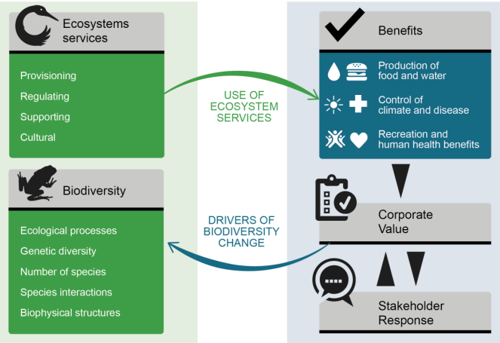
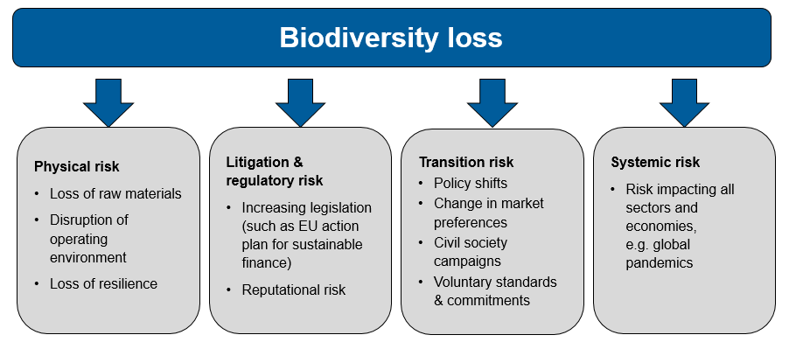
Biodiversity loss = financial risks
>50% of global GDP, USD 44 trillion, is highly or moderately dependent on nature and its services (e.g. provision of fibre, fuel and food)
Financial risk: ongoing rapid loss of biodiversity largely due to human industrial activities putting this value at risk (WEF, 2020)
Cause: the decline is largely the result of human industrial activity
→ In our view, these risks often appear overlooked by the market and are possibly not priced in.
Dependence
Impact
Source: JNCC, 2018 - Adapted from Maes et al., 2013
Sources: HCM, WEF (2020), UN Environment Programme, UNEP Finance Initiative and Global Canopy (2020)
Notes:
Given the link between biodiversity and GDP, it should come as no surprise that there are related financial risks stemming from biodiversity loss for sectors and individual companies
Companies can both have adverse impact as well as depend on biodiversity and ecosystem services –directly and/or indirectly
Ecogain’s biodiversity index (2020) finds that biodiversity is still not a prioritised area among Swedish large caps (or in the Nordics as a whole)
Not priced in today – both due to unawareness but also lack of data
To simplify, we find that a company’s relationship with biodiversity occurs through:
their operations’ impacts on biodiversity (e.g. land-use changes); and/or
their dependence (direct) or their supply chain’s (indirect) dependence on biodiversity

Slide 6
Biodiversity climbing on investors’ agendas
→increasing potential impact on valuation
Respondents’ concern about the impact of
biodiversity loss on financial markets
  This survey supports our view that biodiversity risks appear to be overlooked by the market,
  as 72% of respondents have not assessed the impact of their investments on biodiversity.
  While still in its infancy, we find that biodiversity issues could impact companies’ valuations sooner rather than later, e.g. as more than one third of these respondents that have not yet assessed their investments’ impact on biodiversity, but aim to do so ahead
Source: Credit Suisse and Responsible Investor, 2021
Note: 303 respondents from 35 countries
Notes:
51% believe that biodiversity will be one of the most important topics amongst the investor community by 2030
Business impacts and dependencies on biodiversity translate into risks to business and financial organisations. For investors, biodiversity loss yields a risk to investment returns – e.g. companies which activities harm biodiversity will likely face punitive costs, while firms relying on biodiversity such as food, materials and medicines could see their opportunities diminished.
Regardless of location or products, businesses are dependent on consumers and consumers are growing more aware of and concerned about ecological deterioration, which can affect their purchasing decisions - making biodiversity a key question for many companies…
… along with an increasing investor focus, as firms such as BlackRock states that issues that affect biodiversity and the natural environment will be key focus areas.
Increasing regulatory pressure is also pushing biodiversity high on the agenda.

Slide 7
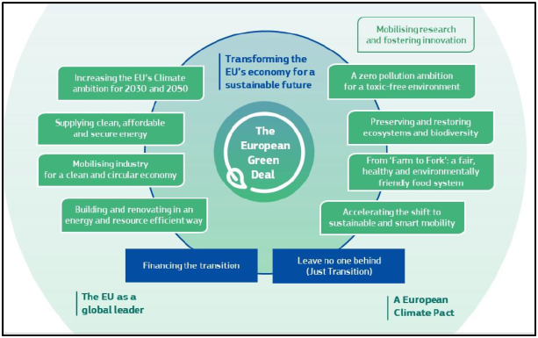
Regulatory shift pushing the topic further up on the agenda
The Taxonomy regulation establishes six environmental objectives:
Climate change mitigation
Climate change adaptation
The sustainable use and protection of water and marine resources
The transition to a circular economy
Pollution prevention and control
The protection and restoration of biodiversity and ecosystems
Source: European Commission
Increasing review and disclosure requirements related to biodiversity for both companies and investors
Notes:
The EU’s new biodiversity strategy for 2030 includes spending goals for biodiversity, aiming to raise EUR 20bn per year for the plan
While typically not an environmental factor that is assigned a value by the markets, we highlight that biodiversity is making its way to financial policy, foremost through the EU Taxonomy, which is set to define what investments will be considered 'green'. Even in the absence of policy, there are financial risks associated with biodiversity loss (e.g. loss of raw materials, increasing regulation, reputation), where companies can be exposed either through the way their operations could contribute to this loss (e.g. extractive industries and industrials) or through their supply chains' dependence on the presence of biodiversity (e.g. forestry, textiles).
Failure to address biodiversity loss will also compromise efforts to achieve other policy objectives, such as climate-change mitigation, and food and water security (OECD, 2019).

Slide 8
Which sectors are at risk?
According to PRI, these are the sectors that have either the highest impact or highest dependence on biodiversity.
Highest impact
on biodiversity
Forest products and fisheries
Food, beverage and tobacco
Mining
Oil & gas
Transportation
Highest dependence
on biodiversity
Forest products and fisheries
Textiles, apparel and
luxury goods
Food, beverage and tobacco
Electric utilities
Independent power producers
We would add energy production in general
  Sources: PRI, IUCN Red List threat data in Maxwell et al (2016) and UN Environment Programme, UNEP Finance Initiative and Global Canopy (2020)
Notes:
Two concepts: impact and dependency. A sector that I think they miss in this mapping when it comes to dependence is Tourism.

Slide 9
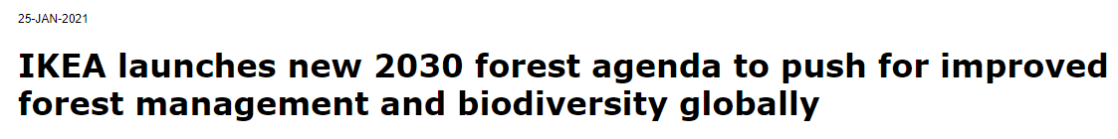
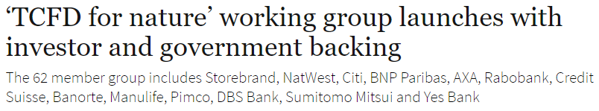
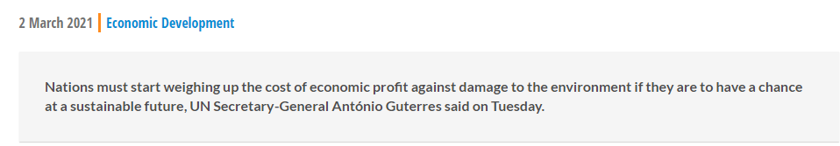
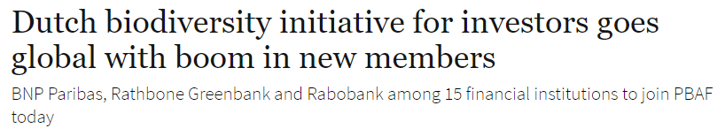
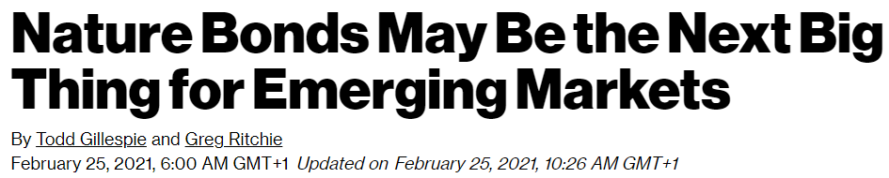
Biodiversity in the limelight
Source: Responsible Investor Sep 25 2020
Source: UN 2021
Source: Responsible Investor Mar 4 2021
Source: Bloomberg 2021
Notes:
Given the link between biodiversity and GDP, it should come as no surprise that there are related financial risks stemming from biodiversity loss for sectors and individual companies
Companies can both have adverse impact as well as depend on biodiversity and ecosystem services –directly and/or indirectly
Ecogain’s biodiversity index (2020) finds that biodiversity is still not a prioritised area among Swedish large caps (or in the Nordics as a whole)
Not priced in today – both due to unawareness but also lack of data
To simplify, we find that a company’s relationship with biodiversity occurs through:
their operations’ impacts on biodiversity (e.g. land-use changes); and/or
their dependence (direct) or their supply chain’s (indirect) dependence on biodiversity

Slide 10
Appendix

Slide 11
Biodiversitetslänkat lån – ett exempel
I mars 2020, kommunicerade det finska skogsbaserade bioindustribolaget UMP
ett €750m kreditfacilitet
Lånefaciliteten var en av de första att koppla lånets räntan till mål för ökad biologisk månfald Räntan var kopplad till två nyckeltal:
En nettopositiv påverkan på biologisk mångfald I bolagets skogar i Finland, och
en 65% reduction av CO2 utsläpp […]
För mer info om hur nettopositiv påverkan på biologisk mångfald defineras och mäte se www.upm.com
Notes:
Attention to biodiversity lags behind other environmental factors, such as climate change, but despite a lack of company reporting, portfolio managers can start to act
Business impacts and dependencies on biodiversity translate into risks to business and financial organisations. For investors, biodiversity loss yields a risk to investment returns – e.g. companies which activities harm biodiversity will likely face punitive costs, while firms relying on biodiversity such as food, materials and medicines could see their opportunities diminished.
Regardless of location or products, businesses are dependent on consumers and consumers are growing more aware of and concerned about ecological deterioration, which can affect their purchasing decisions - making biodiversity a key question for many companies…
… along with an increasing investor focus, as firms such as BlackRock states that issues that affect biodiversity and the natural environment will be key focus areas.
Increasing regulatory pressure is also pushing biodiversity high on the agenda.

Slide 12
Research disclaimer
Risk warning
All investments involve risks and investors are encouraged to make their own decision as to the appropriateness of an investment in any securities referred to in this report, based on their specific investment objectives, financial status and risk tolerance. The historical return of a financial instrument is not a guarantee of future return. The value of financial instruments can rise or fall, and it is not certain that you will get back all the capital you have invested. At times, the expected total returns may fall outside of the above stated ranges because of price movement and/or volatility. Such interim deviations from specified ranges will be permitted but will become subject to review by Research Management
Research disclaimers
Handelsbanken Capital Markets, a division of Svenska Handelsbanken AB (publ) (collectively referred to herein as ‘SHB’), is responsible for the preparation of research reports. SHB is regulated in Sweden by the Swedish Financial Supervisory Authority, in Norway by the Financial Supervisory Authority of Norway, in Finland by the Financial Supervisory Authority of Finland and in Denmark by the Danish Financial Supervisory Authority. All research reports are prepared from trade and statistical services and other information that SHB considers to be reliable. SHB has not independently verified such information.
In no event will SHB or any of its affiliates, their officers, directors or employees be liable to any person for any direct, indirect, special or consequential damages arising out of any use of the information contained in the research reports, including without limitation any lost profits even if SHB is expressly advised of the possibility or likelihood of such damages.
The views contained in SHB research reports are the opinions of employees of SHB and its affiliates and accurately reflect the personal views of the respective analysts at this date and are subject to change. There can be no assurance that future events will be consistent with any such opinions. Each analyst identified in this research report also certifies that the opinions expressed herein and attributed to such analyst accurately reflect his or her individual views about the companies or securities discussed in the research report. This research report does not, and does not attempt to, contain everything material that there is to be said about the company or companies described herein. For additional information about our research methodology please visit, https://reon.researchonline,se/desc/disclaimers
Research reports are prepared by SHB for information purposes only. The information in the research reports does not constitute a personal recommendation or personalised investment advice and such reports or opinions should not be the basis for making investment or strategic decisions. This document does not constitute or form part of any offer for sale or subscription of or solicitation of any offer to buy or subscribe for any securities nor shall it or any part of it form the basis of or be relied on in connection with any contract or commitment whatsoever. Past performance may not be repeated and should not be seen as an indication of future performance. The value of investments and the income from them may go down as well as up and investors may forfeit all principal originally invested. Investors are not guaranteed to make profits on investments and may lose money. Exchange rates may cause the value of overseas investments and the income arising from them to rise or fall. This research product will be updated on a regular basis.

Slide 13
No part of SHB research reports may be reproduced or distributed to any other person without the prior written consent of SHB. The distribution of this document in certain jurisdictions may be restricted by law and persons into whose possession this document comes should inform themselves about, and observe, any such restrictions.
The report does not cover any legal or tax-related aspects pertaining to any of the issuer’s planned or existing debt issuances.
Please be advised of the following important research disclosure statements:
SHB employees, including analysts, receive compensation that is generated by overall firm profitability. Analyst compensation is not based on specific corporate finance or debt capital markets services. No part of analysts’ compensation has been, is or will be directly or indirectly related to specific recommendations or views expressed within research reports.
From time to time, SHB and/or its affiliates may provide investment banking and other services, including corporate banking services and securities advice, to any of the companies mentioned in our research.
We may act as adviser and/or broker to any of the companies mentioned in our research. SHB may also seek corporate finance assignments with such companies.
We buy and sell securities mentioned in our research from customers on a principal basis. Accordingly, we may at any time have a long or short position in any such securities. We may also make a market in the securities of all the companies mentioned in this report. [Further information and relevant disclosures are contained within our research reports.]
SHB, its affiliates, their clients, officers, directors or employees may own or have positions in securities mentioned in research reports.
In conjunction with services relating to financial instruments, the Bank may, under certain circumstances, pay or receive inducements, i.e. fees and commission from parties other than the customer. Inducements may be both monetary and non-monetary benefits. If inducements are paid to or received from a third party, it is required that the payment must aim to improve the quality of the service, and the payment must not prevent the Bank from safeguarding the customer's interests. The customer must be informed about such remuneration that the Bank receives. When the Bank provides investment recommendations, the Bank receives minor non-monetary benefits. Minor non-monetary benefits consist of the following:
Information or documentation about a financial instrument or an investment service that is general in character.
Written material produced by a third party that is an issuer to market a new issue.
Participation at conferences and seminars regarding a specific instrument or investment service
Corporate hospitality up to a reasonable amount.

Slide 14
The Bank has adopted Guidelines concerning Research which are intended to ensure the integrity and independence of research analysts and the research department, as well as to identify actual or potential conflicts of interests relating to analysts or the Bank and to resolve any such conflicts by eliminating or mitigating them and/or making such disclosures as may be appropriate. As part of its control of conflicts of interests, the Bank has introduced restrictions (“Information barriers”) on communications between the Research department and other departments of the Bank. In addition, in the Bank’s organisational structure, the Research department is kept separate from the Corporate Finance department and other departments with similar remits. The Guidelines concerning Research also include regulations for how payments, bonuses and salaries may be paid out to analysts, what marketing activities an analyst may participate in, how analysts are to handle their own securities transactions and those of closely related persons, etc. In addition, there are restrictions in communications between analysts and the subject company. According to the Bank’s Ethical Guidelines for the Handelsbanken Group, the board and all employees of the Bank must observe high standards of ethics in carrying out their responsibilities at the Bank, as well as other assignments. For full information on the Bank’s ethical guidelines, please see the Bank’s website www.handelsbanken.com and click through to About the Group – Policy documents and guidelines – Policy on ethical standards. Handelsbanken has a ZERO tolerance of bribery and corruption. This is established in the Bank’s Group Policy on Bribery and Corruption. The prohibition against bribery also includes the soliciting, arranging or accepting bribes intended for the employee’s family, friends, associates or acquaintances. For full information on the Bank’s Policy against corruption, please see the Bank’s website www.handelsbanken.com and click through to About the Group – Policy documents and guidelines – Policy on ethical standards.
When distributed in the UK
Research reports may be distributed in the UK by SHB.
UK customers should note that neither the UK Financial Services Compensation Scheme for investment business nor the rules of the Financial Conduct Authority made under the UK Financial Services and Markets Act 2000 (as amended) for the protection of private customers apply to this research report and accordingly UK customers will not be protected by that scheme.
This document may be distributed in the United Kingdom only to persons who are authorised or exempted persons within the meaning of the Financial Services and Markets Act 2000 (as amended) (or any order made thereunder) or (i) to persons who have professional experience in matters relating to investments falling within Article 19(5) of the Financial Services and Markets Act 2000 (Financial Promotion) Order 2005 (the “Order”), (ii) to high net worth entities falling within Article 49(2)(a) to (d) of the Order or (iii) to persons who are professional clients under Chapter 3 of the Financial Conduct Authority Conduct of Business Sourcebook (all such persons together being referred to as “Relevant Persons”).

Slide 15
When distributed in the United States
Important Third-Party Research Disclosures:
SHB research is not “globally branded” research and each recipient of SHB research is advised that in the United States, SHB research is distributed by Handelsbanken Markets Securities, Inc., (“HMSI”) an affiliate of SHB. HMSI does not produce research and does not employ research analysts. SHB research and SHB research analysts and its employees are not subject to FINRA’s research analyst rules which are intended to prevent conflicts of interest by, among other things, prohibiting certain compensation practices, restricting trading by analysts and restricting communications with the companies that are the subject of the research report. SHB has no affiliation or business or contractual relationship with HMSI that is reasonably likely to inform the content of SHB research reports; SHB makes all research content determinations without any input from HMSI.
SHB research reports are intended for distribution in the United States solely to “major U.S. institutional investors,” as defined in Rule 15a-6 under the Securities Exchange Act of 1934. Each major U.S. institutional investor that receives a copy of research report by its acceptance hereof represents and agrees that it shall not distribute or provide research reports to any other person.
Any U.S. person receiving SHB research reports that desires to effect transactions in any equity securities discussed within the research reports should call or write HMSI. HMSI is a FINRA Member, telephone number (+1-212-326-5153).
Company-specific disclosures
This report has not been given to the subject company, or any other external party, prior to publication to approve the accuracy of the facts presented.
For company-specific disclosure texts, please consult the Handelsbanken Capital Markets website: https://www.researchonline.se/desc/disclosure.
To find out when a recommendation on a specific company was first published, please consult the Handelsbanken Capital Markets website https://www.researchonline.se/equity/company.

